Slide 1
Cloud Computing
Dr. Md. Nasim Adnan

Slide 2
Definition
In 2011, NIST, the US National Institute of Standards and Technology, defined cloud computing as “a model for enabling ubiquitous, convenient, on-demand network access to a shared pool of configurable computing resources (e.g., networks, servers, storage, applications, and services) that can be rapidly provisioned and released with minimal management effort or service provider interaction”.

Slide 3
The cloud computing movement is motivated by the idea that data processing and storage can be done more efficiently on large computing and storage systems accessible via the Internet.
Computer clouds support a paradigm shift from local to network-centric distant data centers providing the computing and storage resources.
In this new paradigm users relinquish control of their data and application to Cloud Service Providers.

Slide 4
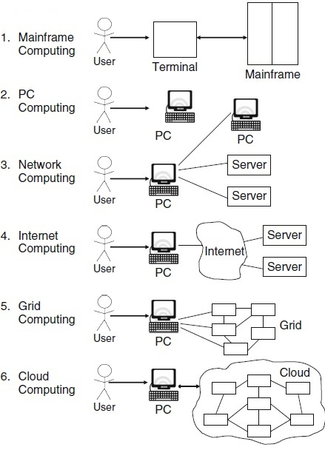
Evolution of Cloud Computing

Slide 5
Cloud computing is characterized by five attributes:
On-demand self-service
Broad network access
Resource pooling
Rapid elasticity
Measured service

Slide 6
Cloud Models
Most people separate cloud computing into two distinct sets of delivery models:
Service Delivery Models: This consists of the particular types of services that you can access on a cloud computing platform.
Deployment models: This refers to the location and management of the cloud’s infrastructure.

Slide 7
Service Delivery Models
Cloud computing has the following Service Delivery Models:
Infrastructure as a Service (IaaS): IaaS refers to computing resources as a service. This includes virtualized computers with guaranteed processing power and reserved bandwidth for Internet access. In IaaS, service provider manages all the infrastructure, while the client is responsible for all other aspects of the deployment. This can include the operating system, applications, and user interactions with the system.
Platform as a Service (PaaS): PaaS is similar to IaaS, but also includes operating systems and required services for a particular application. In other words, PaaS is IaaS with enabling software stack for the given application. The service provider manages the cloud infrastructure, the operating systems, and the enabling software stack. The client is responsible for installing and managing the application that it is deploying.

Slide 8
Software as a Service: SaaS allows users to run applications remotely from the cloud. The application is provided to the client through a thin client interface (a browser, usually), and the customer’s responsibility begins and ends with entering and managing its data and user interaction. With SaaS, vendor is responsible for the installation of the application, its maintenance, or its upkeep.
The aforementioned three different service models taken together have come to be known as the SPI model of cloud computing. Many other service models have been mentioned: StaaS – Storage as a Service; IdaaS – Identity as a Service; CmaaS – Compliance as a Service; DBaaS – database as a service (a more recent addition to the service delivery models) and so forth.
However, the SPI services encompass all the other possibilities.

Slide 9
Deployment Models
Public cloud: The public cloud infrastructure is available for public use and is owned by an organization selling cloud services.
Private cloud: The private cloud infrastructure is operated for the exclusive use of an organization. The cloud may be managed by that organization or a third party. Private clouds may be either on- or off-premises.
Hybrid cloud: A hybrid cloud combines multiple types of clouds (private, community or public) where those clouds retain their unique identities, but are bound together as a unit.

Slide 10
Community cloud: A community cloud is one where the cloud has been organized to serve a common function or purpose.
It may be for one organization or for several organizations, but they share common concerns such as their mission, policies, security, regulatory compliance needs, and so on.
A community cloud may be managed by the constituent organization(s) or by a third party.

Slide 11
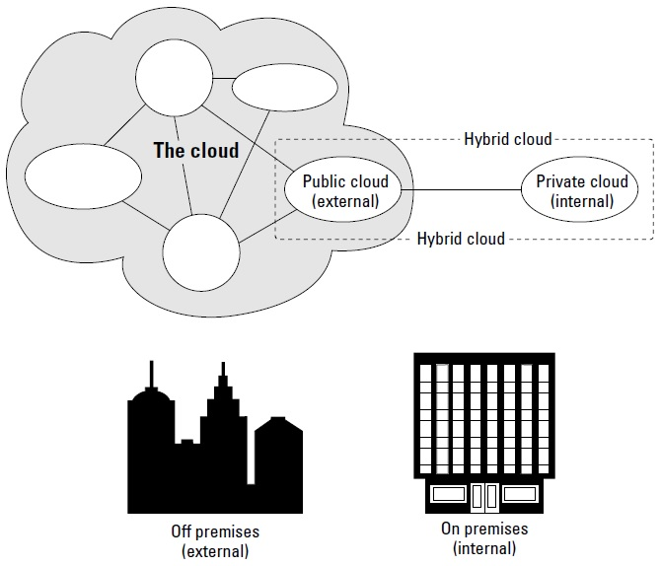

Slide 12
Crucial Technologies: Datacenters
When you choose a cloud service provider, you are renting or leasing part of an enormous infrastructure of data centers, computers, storage, and networking capacity.
Many of these data centers are multi-million-dollar investments by the companies that run them. To give you some sense of scale, it has been estimated that a state-of-the-art microchip fabrication facility can cost anywhere from $2 to $5 billion.
By comparison, a state of the art cloud computing datacenter can run in the range of $100 million. Most of the large cloud computing service providers have multiple datacenters located all over the world.

Slide 13
As these various datacenters grew in size, businesses have developed their datacenters as “greenfield” projects. Datacenters have been sited to do the following:
Have access to low cost power
Leverage renewable power source
Be near abundant water
Be sited where high-speed network backbone connections can be made
Keep land costs modest and occupation unobtrusive
Obtain tax breaks
Optimize the overall system latency

Slide 14
Crucial Technologies: The Internet
It has been estimated that the Internet consumes roughly 10 percent of the world’s total power. However, it is worth mentioning that through the Internet, cloud computing has become a reality.
According to the research firm IDC, the following areas were the top five cloud applications in use in 2010:
Collaboration applications
Web applications/Web serving
Cloud backup
Business applications
Personal productivity applications

Slide 15
Crucial Technologies: Virtualization
The advantage of cloud computing is the ability to virtualize and share resources among different applications with the objective for better server utilization.
In non-cloud computing, three independent platforms exist for three different applications running on its own server. In the cloud, servers can be shared, or virtualized, for operating systems and applications resulting in fewer servers.
Virtualization technologies include virtual machine techniques such as VMware and Xen, and virtual networks, such as VPN.

Slide 16
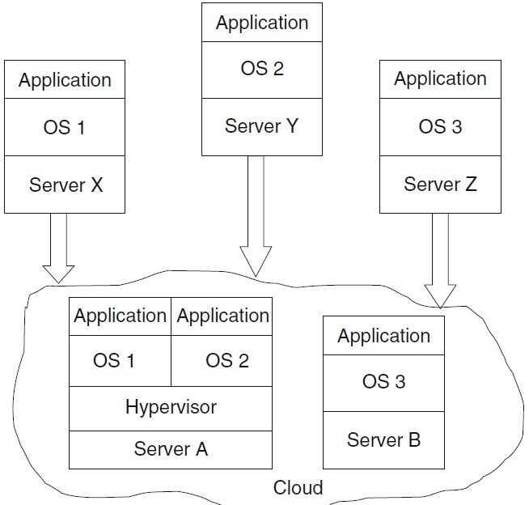
A hypervisor, also known as a virtual machine monitor or VMM, is software that creates and runs Virtual Machines (VMs).

Slide 17
Benefits of Cloud Computing
Cloud computing is cost-effective because of resource multiplexing. Application data is stored closer to the site where it is used in a manner that is device and location-independent; potentially, this data storage strategy increases reliability, as well as security.
The maintenance and the security are ensured by service providers. Organizations using computer clouds are relieved of supporting large IT teams, acquiring and maintaining costly hardware and software, and paying large electricity bills.
Cloud computing offers scalable and elastic computing and storage services. The resources used for these services can be metered and the users can be charged only for the resources they used.

Slide 18
Depending upon the type of service being offered, you may find that you do not require hardware or software licenses to implement your service. As the system is centralized patches and upgrades can be applied easily. This means your users always have access to the latest software versions.
The Quality of Service (QoS) is something that you can obtain under contract from your vendor.
The ability to provide load balancing and failover makes them highly reliable, often much more reliable than what you can achieve from own IT arrangements.
Cloud computing is a business reality as large number of organizations have adopted this paradigm. In particular, Cloud computing dramatically reduces the upfront capital expenditures. In cloud computing, anyone can be a giant at any time.

Slide 19
Related Issues
Cloud computing is based on a paradigm shift with profound implications on computing ethics. The main elements of this shift are:
The control is relinquished to third party services.
The data is stored on multiple sites administered by several organizations.
Multiple services interoperate across the network.
Unauthorized access, data corruption, infrastructure failure, and service unavailability are some of the risks related to relinquishing the control to third party services; moreover, whenever a problem occurs, it is difficult to identify the source and the entity causing it.
Systems can span the boundaries of multiple organizations and cross the international borders.

Slide 20
If you had to pick a single area of concern in cloud computing, that area would undoubtedly be privacy and security. When your data travels over and rests on systems that are no longer under your control, you have increased risk due to the interception and malfeasance of others.
Accountability is a necessary ingredient of cloud computing; adequate information about how data is handled within the cloud and about allocation of responsibilities are key elements for enforcing rules in cloud computing.
The need for International rules and regulations for the governance of cloud computing are obvious.

Slide 21
As a general rule, the advantages of cloud computing present a more compelling case for small organizations than for larger ones.
Larger organizations can support investment for IT infrastructure, development efforts and IT staff that put in place custom-made software solutions that are crafted with their particular needs in mind.
All cloud computing applications suffer from the inherent latency that is intrinsic in their WAN connectivity.
While cloud computing applications excel at large-scale processing tasks, if your application needs large amounts of data transfer, cloud computing may not be the best model for you.

Slide 22
Clouds are affected by malicious attacks and failures of the infrastructure, e.g., power failures. Such events can affect the Internet domain name servers and prevent access to a cloud or can directly affect the cloud.
For example, an attack at Akamai on June 15, 2004 caused a domain name outage and a major blackout that affected Google, Yahoo, and many other sites. In May 2009, Google was the target of a serious Denial of Service (DoS) attack which took down services like Google News and Gmail for several days.
Lightning caused a prolonged down time at Amazon on June 29–30, 2012. The AWS cloud in the East region of the USA consists of ten data centers across four availability zones.

Slide 23


